Slide 1












#MSTechCommunityAPACOnline
Tech Sharing
Azure, Office and Data Community
By Senthamil Selvan, Office Development MVP

Slide 2


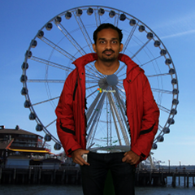
About Me
Microsoft MVP (Office Development)
Working as SharePoint Consultant

Slide 3
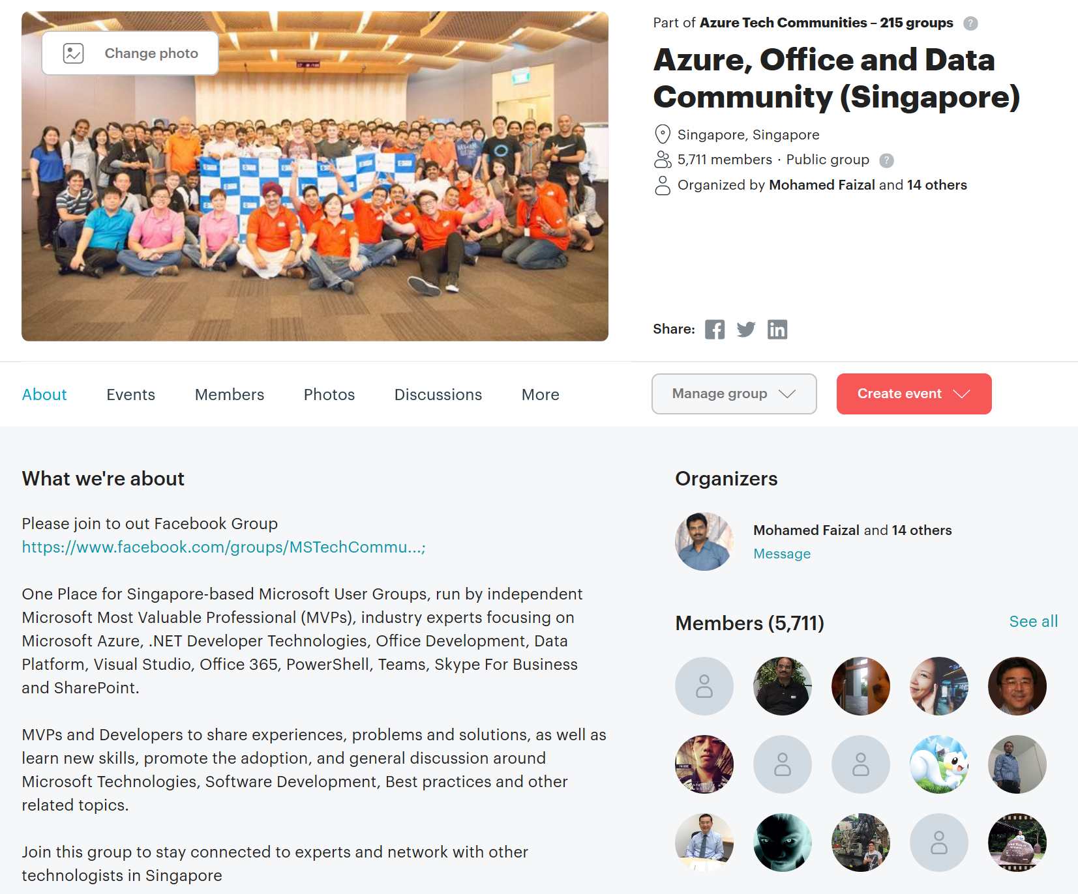
Tech Community APAC Online

Slide 4
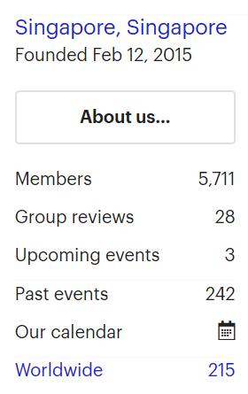
Azure, Office and Data Community
https://www.meetup.com/mssgug/
5700+ Members
One stop User Group in Singapore focusing on Azure, O365 & Data
3 meetups a month.
Azure Boot camp, Singapore Data Day & M365 Developer Bootcamp

